Slide 1
Hyperabundance of endemic species and pink salmon in the Indian River
Brian McGreal

Slide 2
Hyperabundance of endemic species

Slide 3
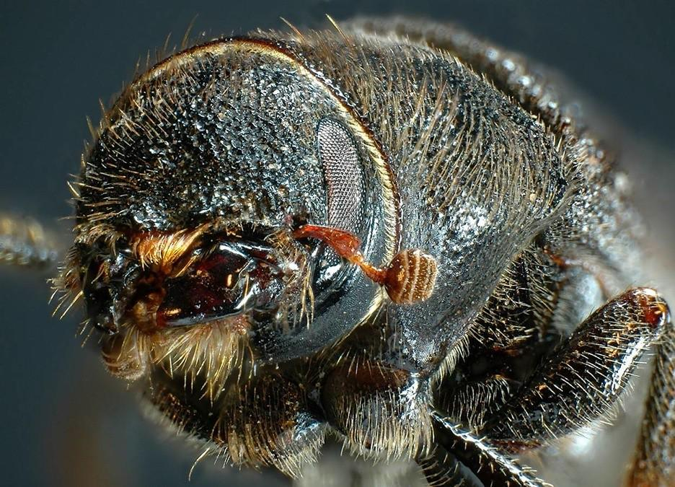
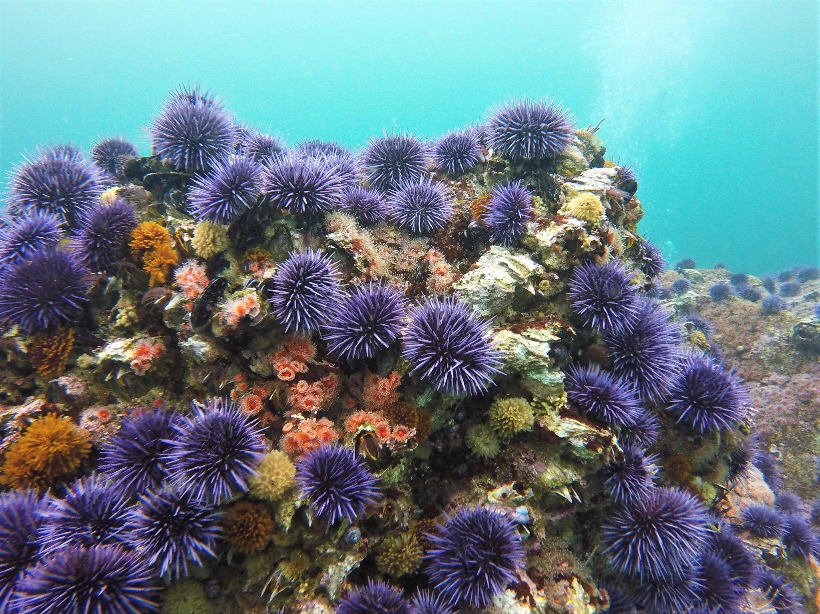
Hyperabundance of endemic species
Mountain pine beetle
Pacific sea urchins
Credit: Simon Fraser University, Oregon State University

Slide 4
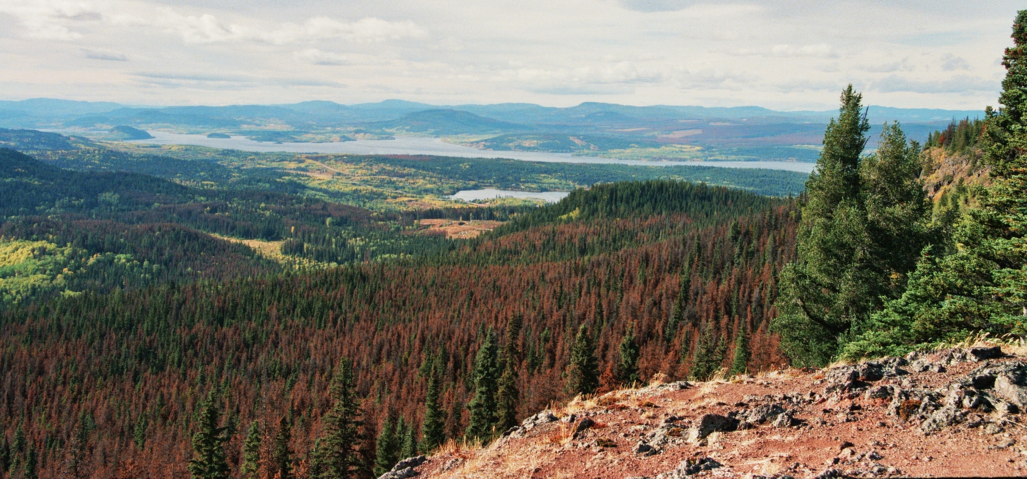

Hyperabundance of Endemic Species
Mountain pine beetle
Credit: Themightyquill

Slide 5
Hyperabundance of Endemic Species
Mountain pine beetle
- Endemic to western US and Canada
Credit: Themightyquill

Slide 6
Hyperabundance of Endemic Species
Mountain pine beetle
- Endemic to western US and Canada
- Life cycle destroys coniferous trees
Credit: Themightyquill

Slide 7
Hyperabundance of Endemic Species
Mountain pine beetle
- Endemic to western US and Canada
- Life cycle destroys coniferous trees
- Shifting climate has led to frequent outbreaks
Credit: Themightyquill

Slide 8
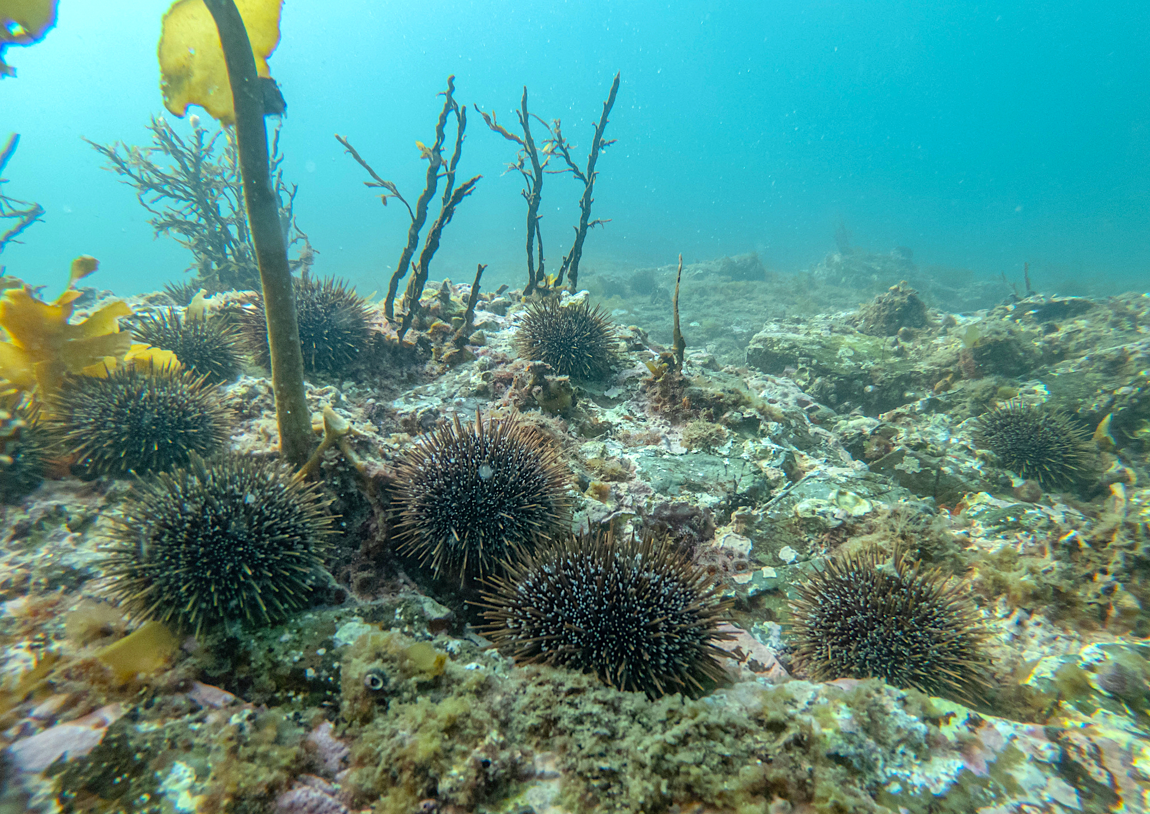
Hyperabundance of Endemic Species
Pacific sea urchins
Credit: Shaun Lee

Slide 9
Hyperabundance of Endemic Species
Pacific sea urchins
- Pacific coast of US and Canada
Credit: Shaun Lee

Slide 10
Hyperabundance of Endemic Species
Pacific sea urchins
- Pacific coast of US and Canada
- Life cycle destroys kelp forests
Credit: Shaun Lee

Slide 11
Hyperabundance of Endemic Species
Pacific sea urchins
- Pacific coast of US and Canada
- Life cycle destroys kelp forests
- Decimated otter populations have reduced natural predation
Credit: Shaun Lee

Slide 12
Hyperabundance of endemic species
Broad regional trends
Direct intervention

Slide 13
Why am I talking about this?

Slide 14
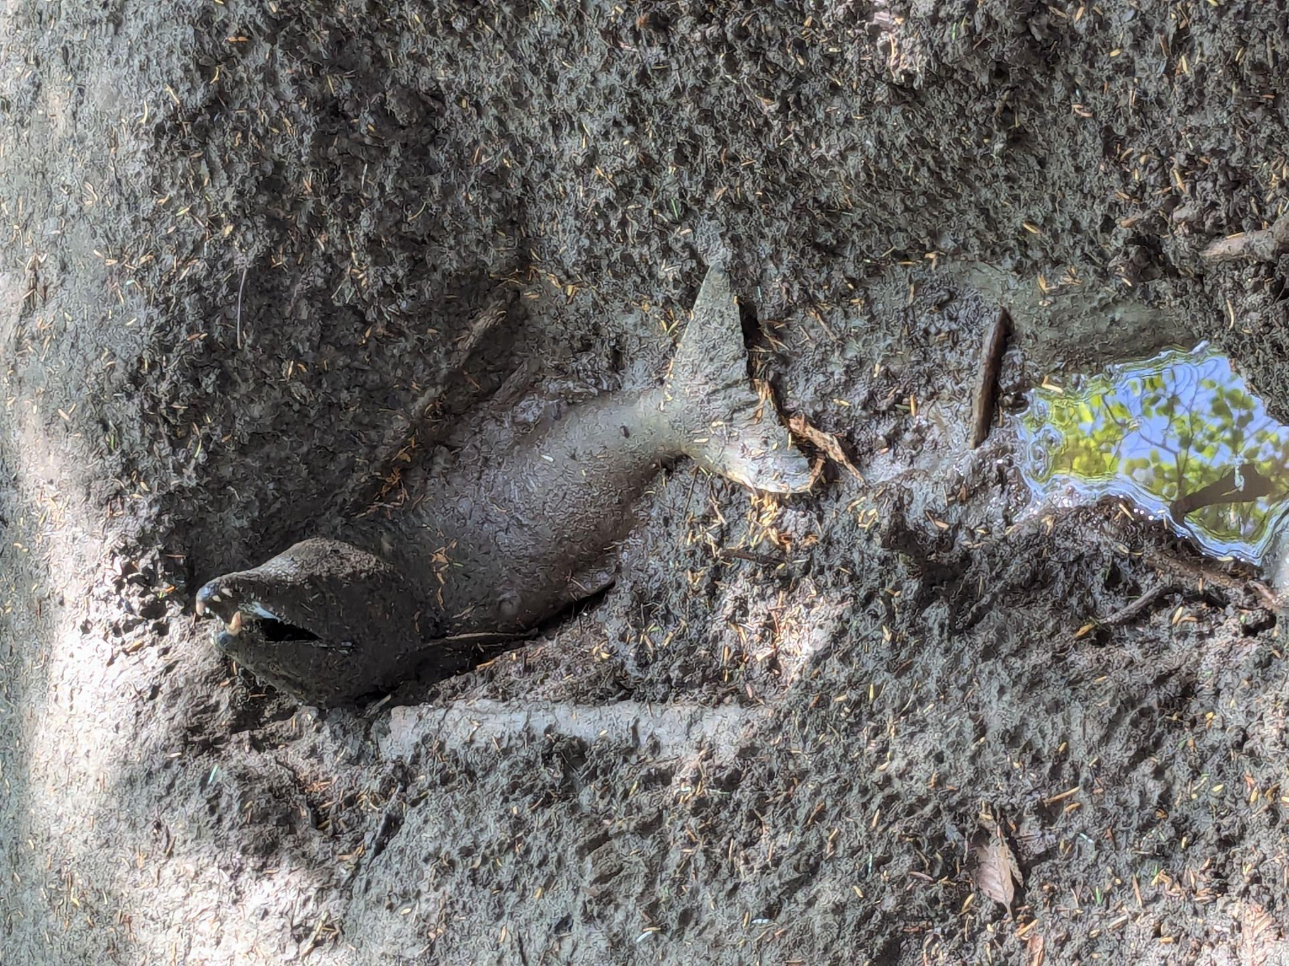
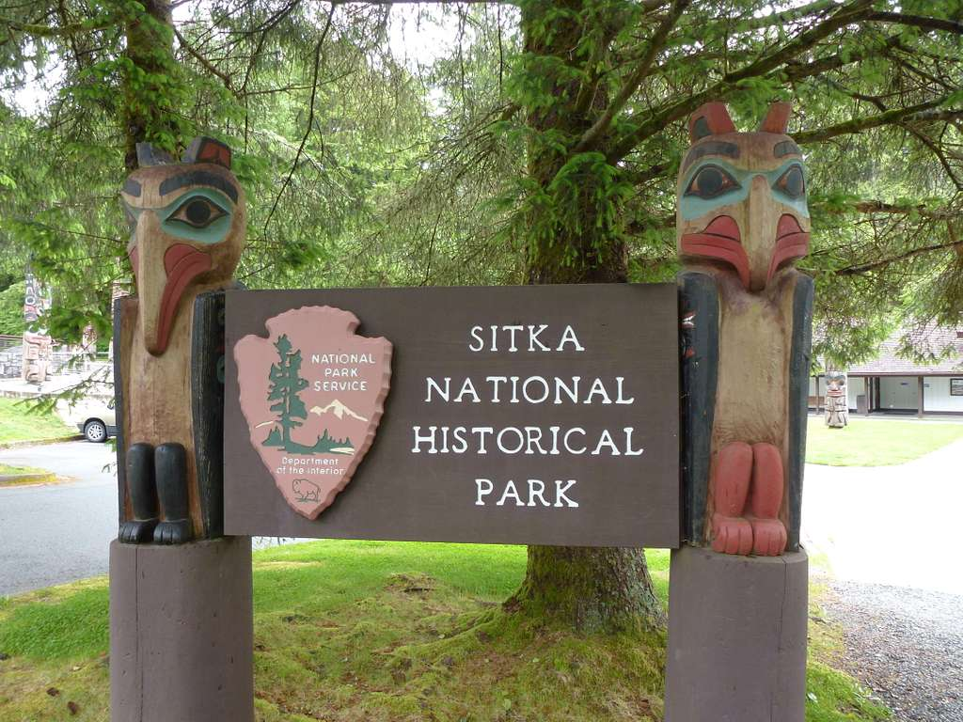
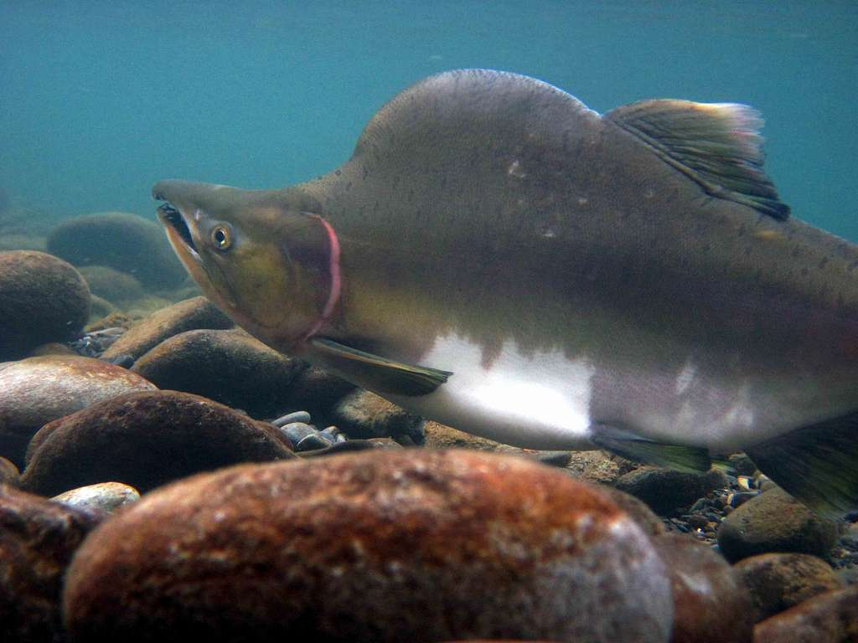
Research focus
- Indian River, Sitka National Historical Park
Credit: John Bromley

Slide 15
Research focus
- Indian River, Sitka National Historical Park
- Recent decades have seen rapid increase in pink salmon run size

Slide 16
Research focus
- Indian River, Sitka National Historical Park
- Recent decades have seen rapid increase in pink salmon run size
- Nearby hatchery rearing and releasing pink salmon may be driving abundance

Slide 17
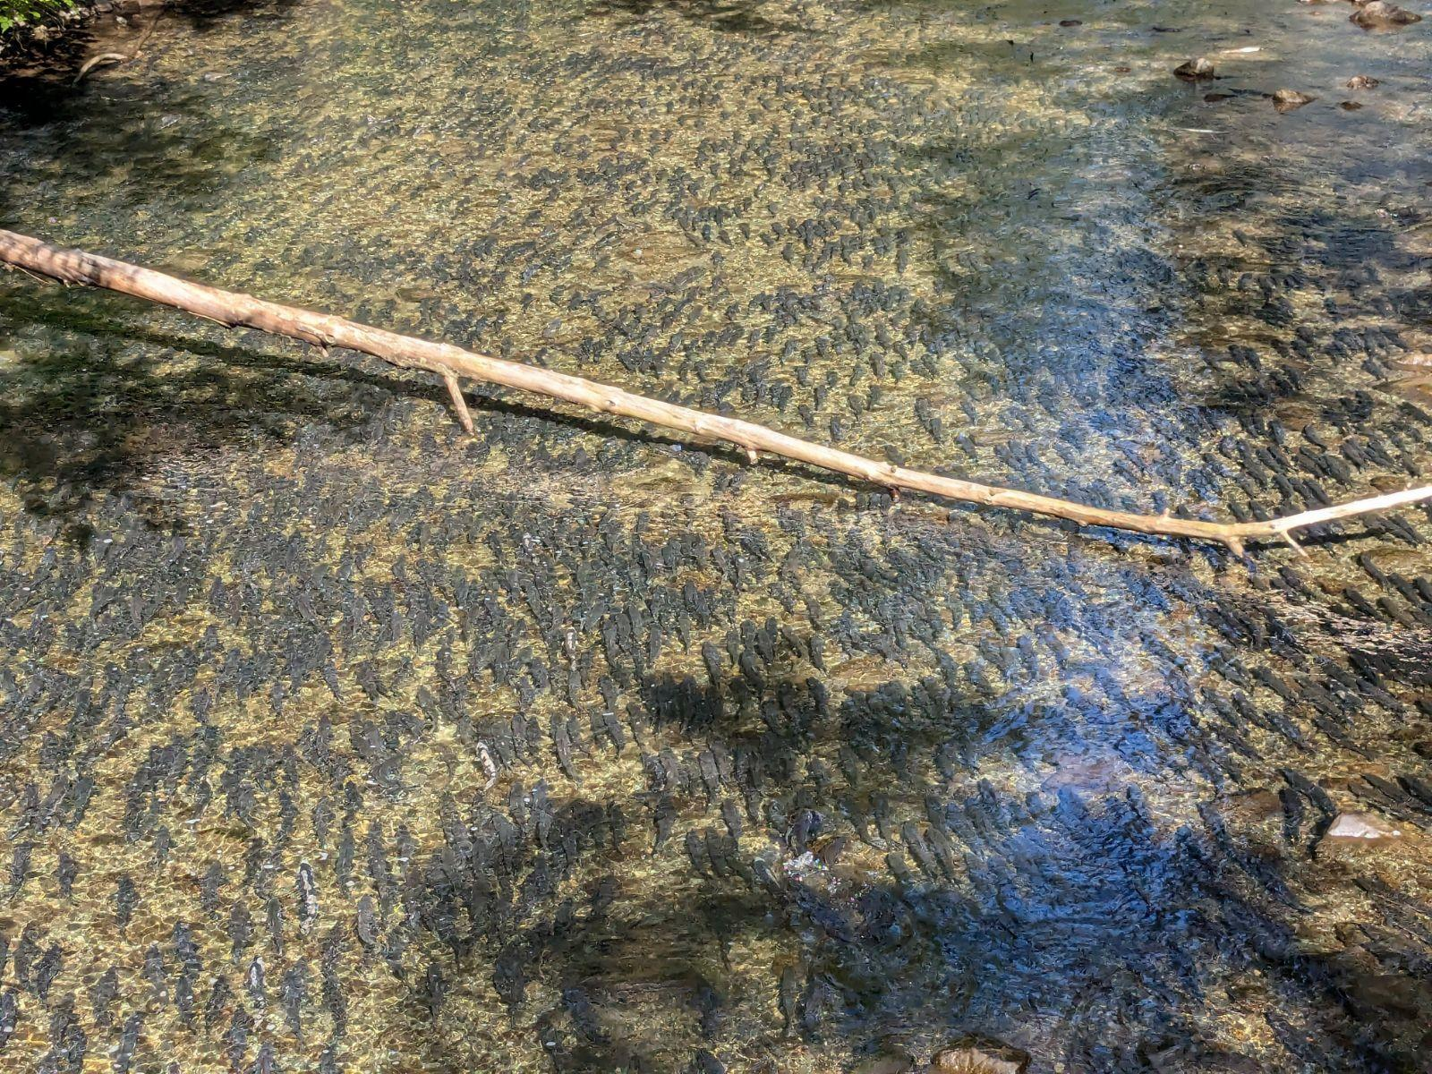
Presentation in three parts
- Background on pink salmon and Indian River
- Question 1: Are abundances seen at Indian River unusual?
- Question 2: Are hatchery releases driving Indian River pink salmon abundance?

Slide 18
Presentation in three parts
- Background on pink salmon and Indian River
- Question 1: Are abundances seen at Indian River unusual?
- Question 2: Are hatchery releases driving Indian River pink salmon abundance?

Slide 19
Presentation in three parts
- Background on pink salmon and Indian River
- Question 1: Are abundances seen at Indian River unusual?
- Question 2: Are hatchery releases driving Indian River pink salmon abundance?

Slide 20
Presentation in three parts
- Background on pink salmon and Indian River
- Question 1: Are abundances seen at Indian River unusual?
- Question 2: Are hatchery releases driving Indian River pink salmon abundance?

Slide 21
Background

Slide 22
Pink Salmon in Southeast Alaska
Credit: National Parks Gallery
Notes:
Move this up up

Slide 23
Pink Salmon in Southeast Alaska
- Very abundant, most numerous salmon species in the region

Slide 24
Pink Salmon in Southeast Alaska
- Very abundant, most numerous salmon species in the region
- High rates of straying relative to other salmon species

Slide 25
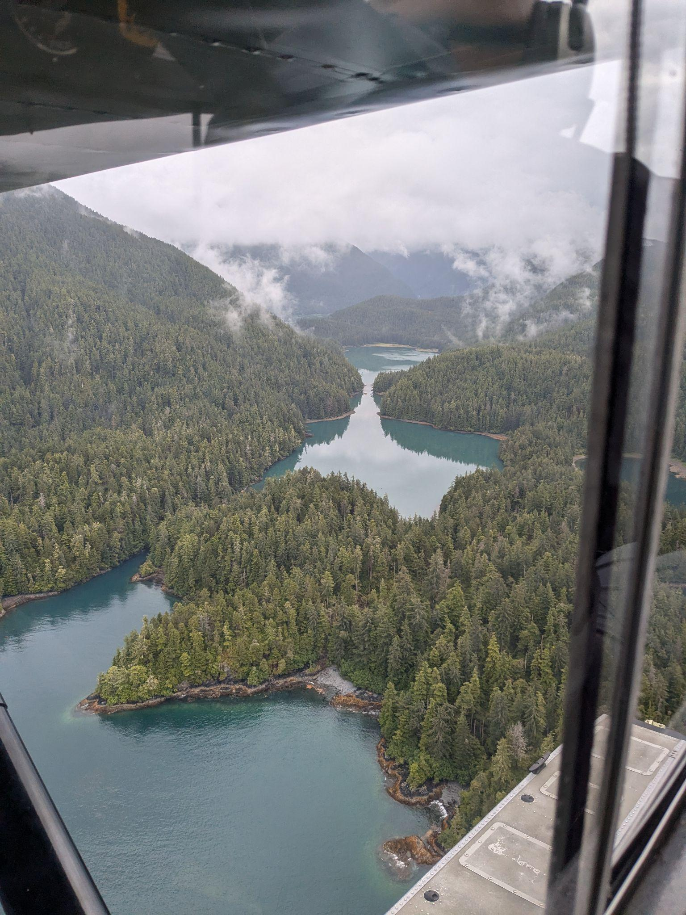
Pink Salmon in population data
Alaska Dept of Fish Game
Fixed wing aircraft survey monitoring escapement

Slide 26
Pink Salmon in population data
Alaska Dept of Fish Game
Fixed wing aircraft survey monitoring escapement
714 pink salmon index streams in SE Alaska

Slide 27
Pink Salmon in population data
Alaska Dept of Fish Game
Fixed wing aircraft survey monitoring escapement
714 pink salmon index streams in SE Alaska
(35 in N. Southeast, Outside)

Slide 28
Pink Salmon in population data
Alaska Dept of Fish Game
Fixed wing aircraft survey monitoring escapement
714 pink salmon index streams in SE Alaska
(35 in N. Southeast, Outside)
- Data validated by random foot counts

Slide 29
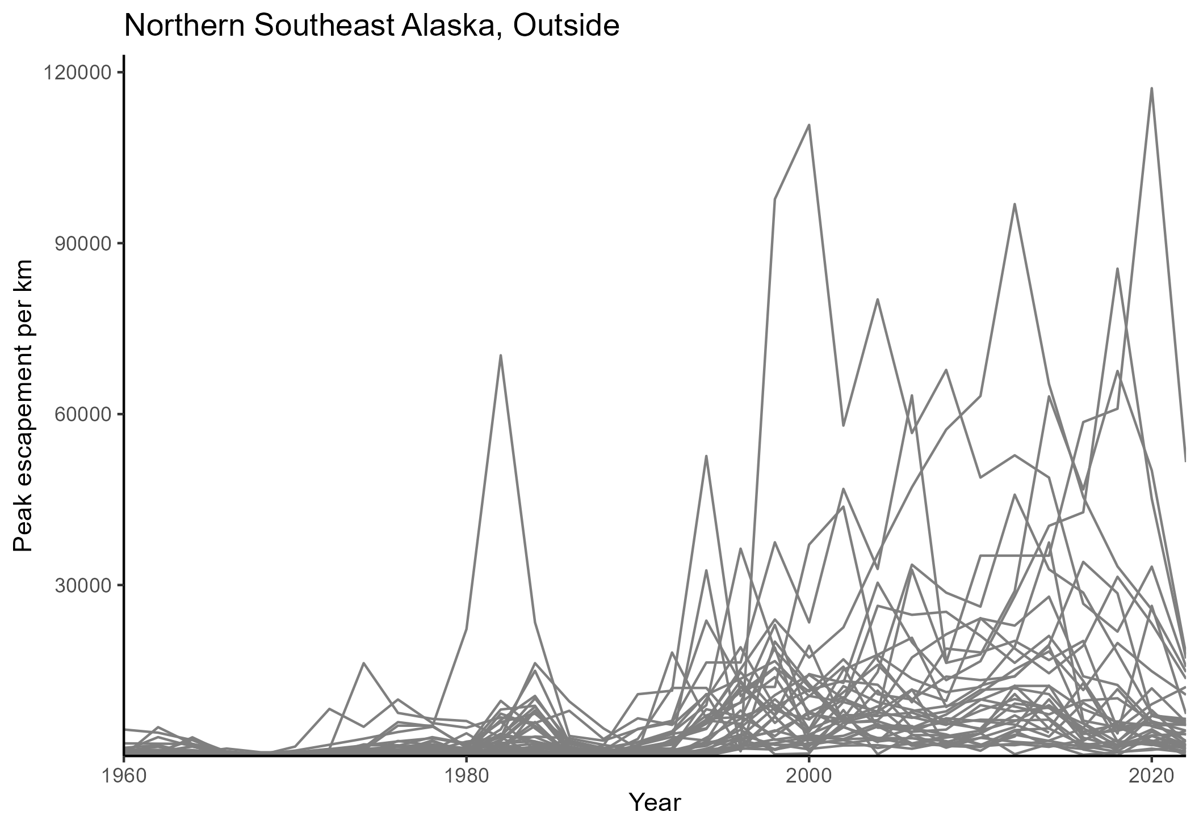
Pink Salmon in Southeast Alaska

Slide 30
Pink Salmon in Southeast Alaska
- Most pink salmon index populations have seen substantial growth since 1990

Slide 31
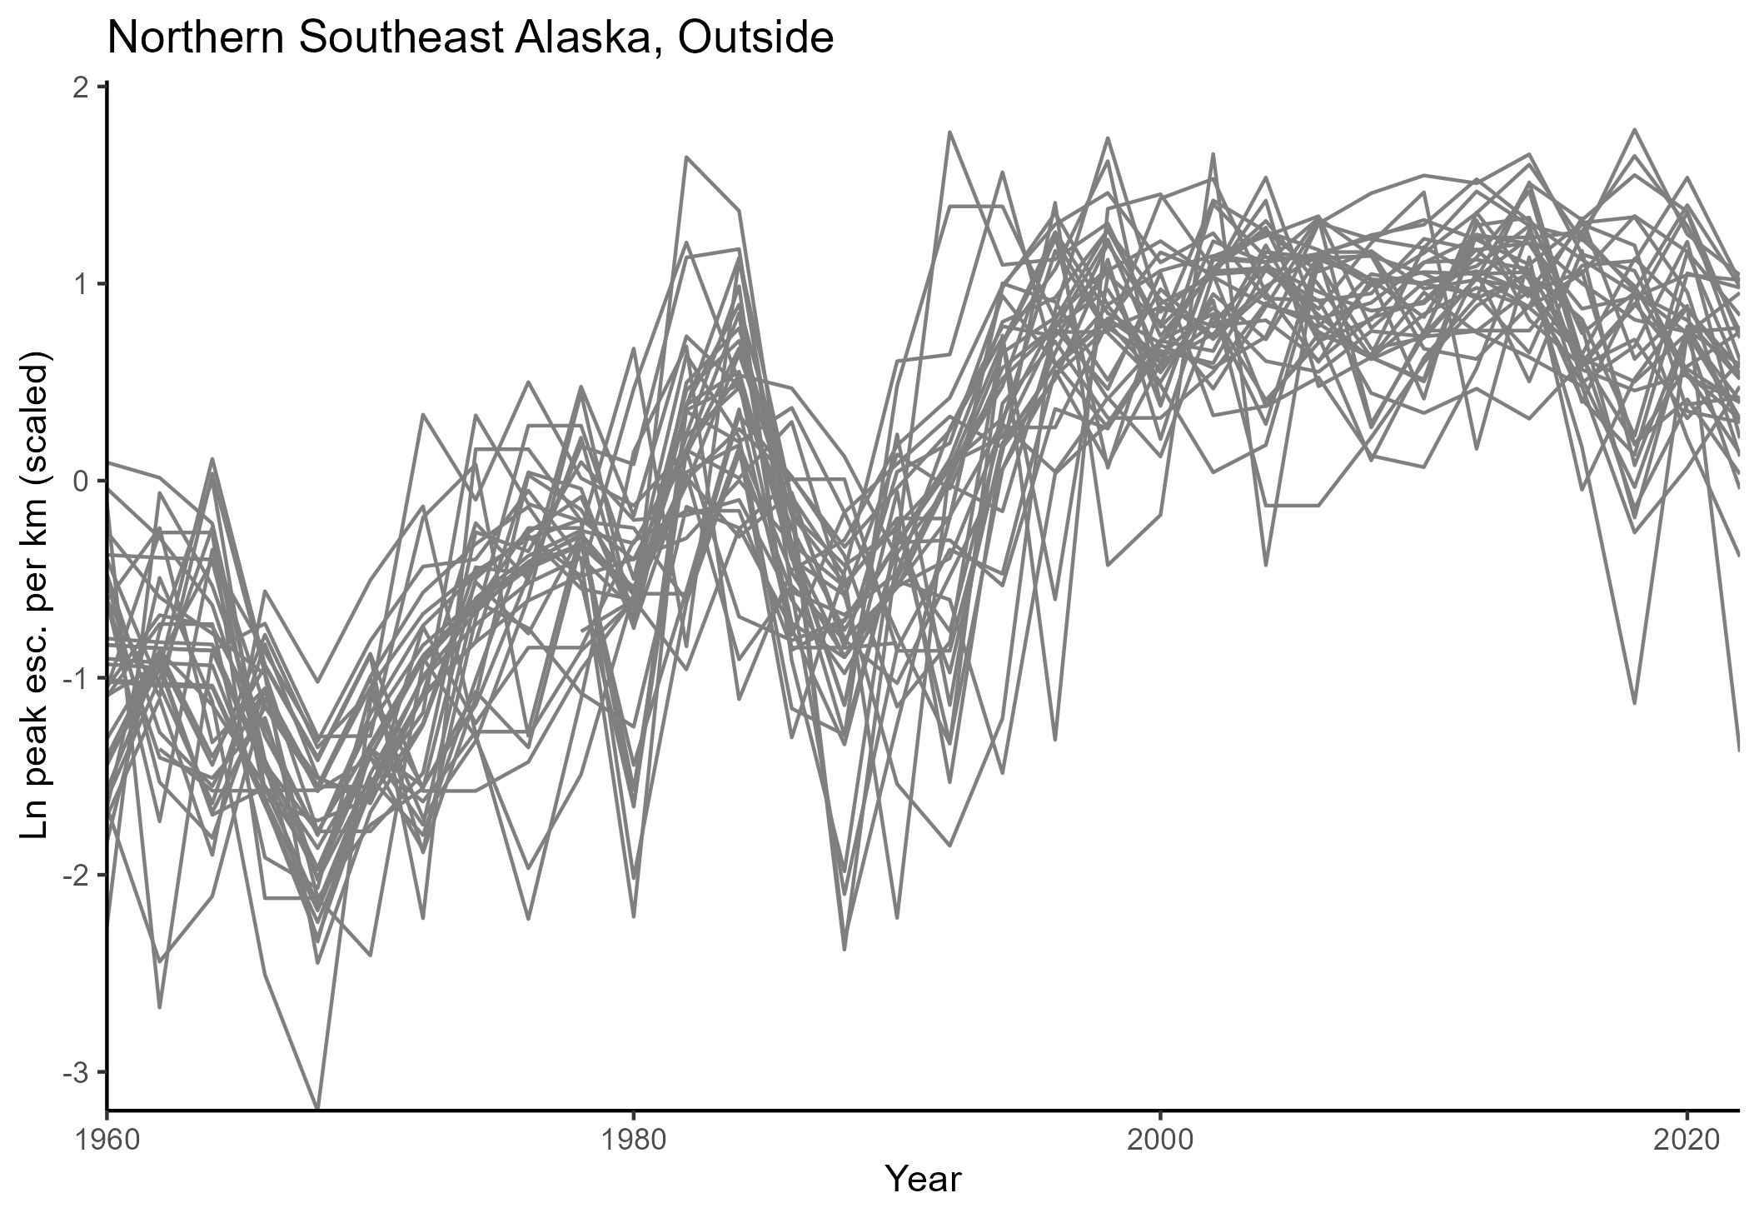
Pink Salmon in Southeast Alaska
- Most pink salmon index populations have seen substantial growth since 1990

Slide 32
Credit: John Bromley

Slide 33
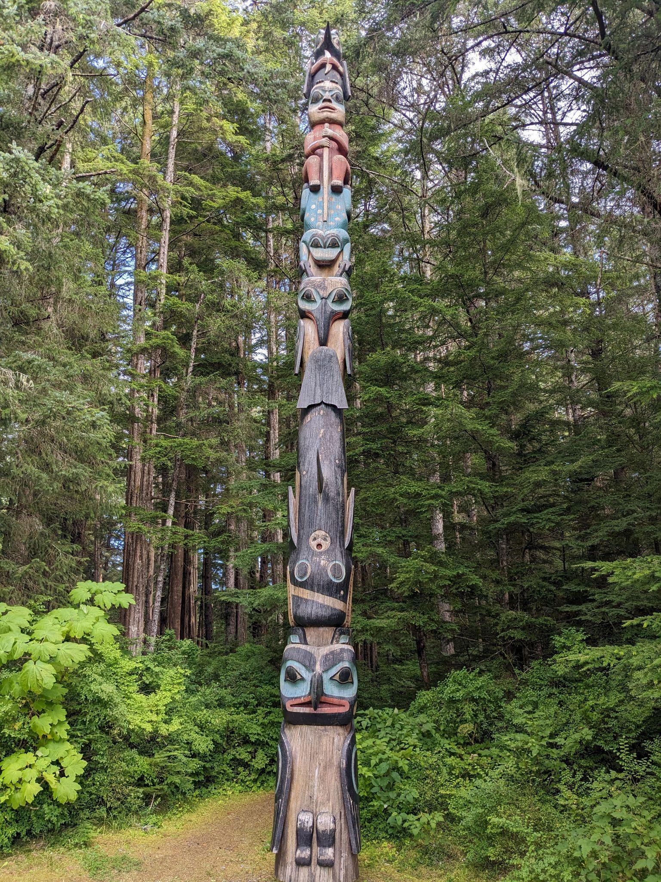
Sitka National Historical Park – History

Slide 34
Sitka National Historical Park – History
- Ancestral home of Kiks.ádi clan (Sitka Tribe of Alaska)

Slide 35
Sitka National Historical Park – History
- Ancestral home of Kiks.ádi clan (Sitka Tribe of Alaska)
- Site of pivotal 1802 & 1804 battles with Russian colonizers

Slide 36
Sitka National Historical Park – History
- Ancestral home of Kiks.ádi clan (Sitka Tribe of Alaska)
- Site of pivotal 1802 & 1804 battles with Russian colonizers
- Declared a National Monument in 1910, National Historical Park in 1972
Notes:
Due to the history, and numerous totem poles (none of which were local in origin)

Slide 37
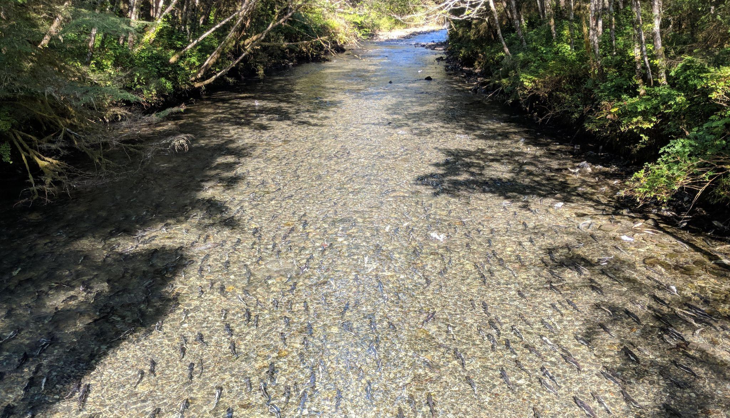
Sitka National Historical Park – Indian River
Notes:
a.k.a. Kaasda Héen
Predominant natural feature
Supports chum and coho runs
Home to rainbow trout, Dolly Varden, cutthroat trout, stickleback, sculpin
Supports large pink salmon runs

Slide 38
Sitka National Historical Park – Indian River
- Kiks.ádi fishing camp established in the ancient past
(Sitka Tribe of Alaska)
Notes:
a.k.a. Kaasda Héen
Predominant natural feature
Supports large pink salmon runs
Home to rainbow trout, Dolly Varden, cut

Slide 39
Sitka National Historical Park – Indian River
- Kiks.ádi fishing camp established in the ancient past
(Sitka Tribe of Alaska)
- Strong pink salmon runs into 20th century”
Notes:
a.k.a. Kaasda Héen
Predominant natural feature
Supports large pink salmon runs
Home to rainbow trout, Dolly Varden, cut

Slide 40
Sitka National Historical Park – Indian River
- Kiks.ádi fishing camp established in the ancient past
(Sitka Tribe of Alaska)
- Strong pink salmon runs into 20th century”
“…it seemed like you should just be able to walk across the river on the humpies, there were so many of them.” –Isabella Brady, Tlingit elder
Notes:
a.k.a. Kaasda Héen
Predominant natural feature
Supports large pink salmon runs
Home to rainbow trout, Dolly Varden, cut

Slide 41
Sitka National Historical Park – Indian River
- Kiks.ádi fishing camp established in the ancient past
(Sitka Tribe of Alaska)
- Strong pink salmon runs into 20th century”
“…it seemed like you should just be able to walk across the river on the humpies, there were so many of them.” –Isabella Brady, Tlingit elder
- Beginning in 1939, gravel removal decimated salmon runs
Notes:
a.k.a. Kaasda Héen
Predominant natural feature
Supports large pink salmon runs
Home to rainbow trout, Dolly Varden, cut

Slide 42
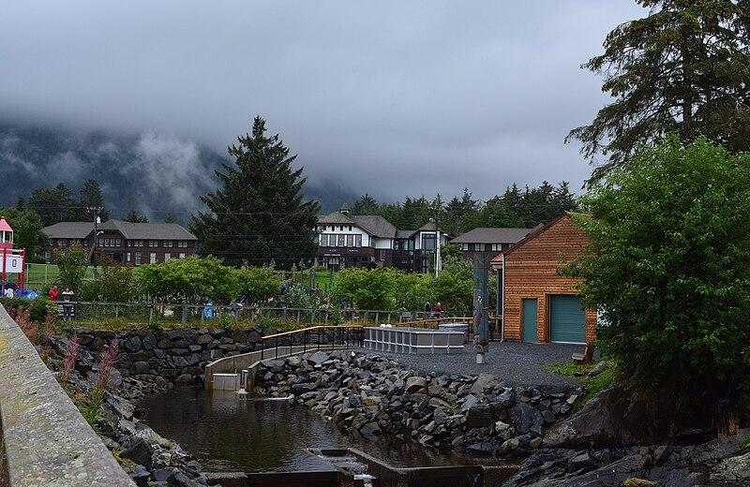
Sitka National Historical Park – Sheldon Jackson Hatchery
Credit: Joe Mabel
Notes:
Who runs the hatchery? SSSC – include this

Slide 43
Sitka National Historical Park – Sheldon Jackson Hatchery
- Non-profit educational hatchery

Slide 44
Sitka National Historical Park – Sheldon Jackson Hatchery
- Non-profit educational hatchery
- Releases 3 million pink salmon per year

Slide 45
Sitka National Historical Park – Sheldon Jackson Hatchery
- Non-profit educational hatchery
- Releases 3 million pink salmon per year
- Aided recovery of pink salmon run in 1970s

Slide 46
Sitka National Historical Park – Sheldon Jackson Hatchery
- Non-profit educational hatchery
- Releases 3 million pink salmon per year
- Aided recovery of pink salmon run in 1970s
- Draws water from Indian River

Slide 47
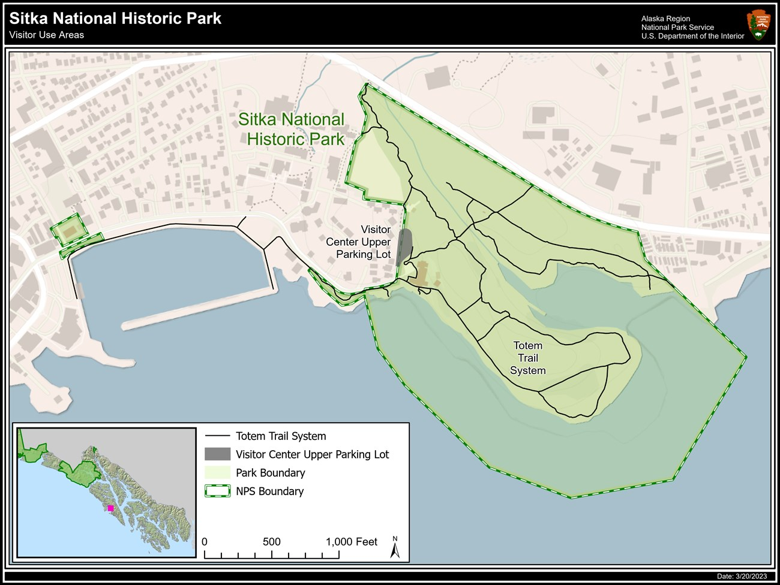
Sitka National Historical Park
Sheldon Jackson Hatchery
Credit: National Park Service
Notes:
I want to show this earlier

Slide 48

Sitka National Historical Park
Sheldon Jackson Hatchery

Slide 49
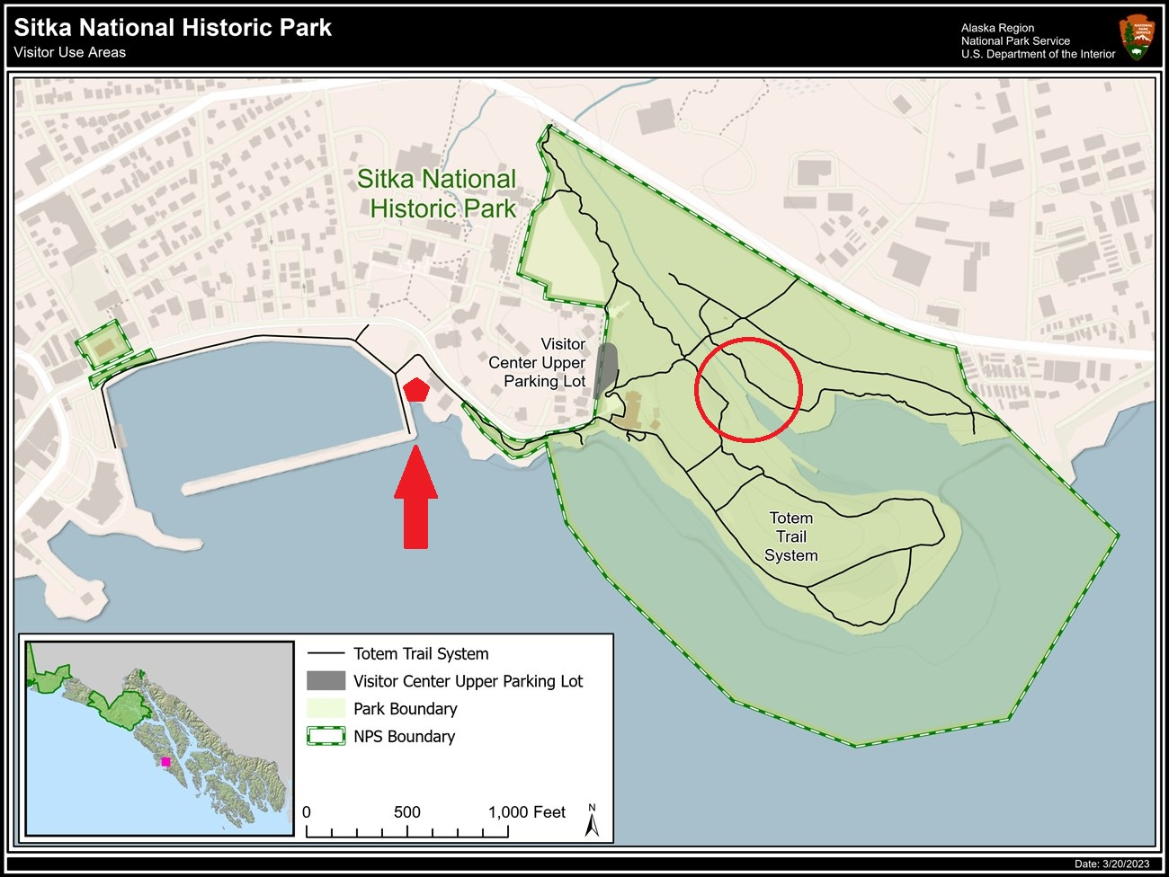
Sitka National Historical Park
Sheldon Jackson Hatchery
Notes:
Approx. 1,600 feet from hatchery to river mouth

Slide 50
Since 1990s, pink salmon poulations at Indian River have increased dramatically…
Notes:
a.k.a. Kaasda Héen
Predominant natural feature
Supports large pink salmon runs
Home to rainbow trout, Dolly Varden, cut

Slide 51
Hyperabundance - implications

Slide 52
Hyperabundance - implications
- Decomposition of pink salmon depletes dissolved oxygen in stream

Slide 53
Hyperabundance - implications
- Decomposition of pink salmon depletes dissolved oxygen in stream
- Flows typically low during late summer salmon run

Slide 54
Hyperabundance - implications
- Decomposition of pink salmon depletes dissolved oxygen in stream
- Flows typically low during late summer salmon run
- Potentially fatal events for other species dependent on Indian River

Slide 55
National Parks and conservation
“[The National Park Service] shall promote and regulate the use of Federal areas known as national parks… which purpose is to conserve the scenery and the natural and historic objects and the wildlife therein and to provide for the enjoyment of the same in such manner and by such means as will leave them unimpaired for the enjoyment of future generations”
–NPS Organic Act of 1916

Slide 56

Hyperabundance of pink salmon
Broad regional trends
Direct intervention

Slide 57
Question 1

Slide 58
Question 1: Where does the Indian River fit in this picture?

Slide 59
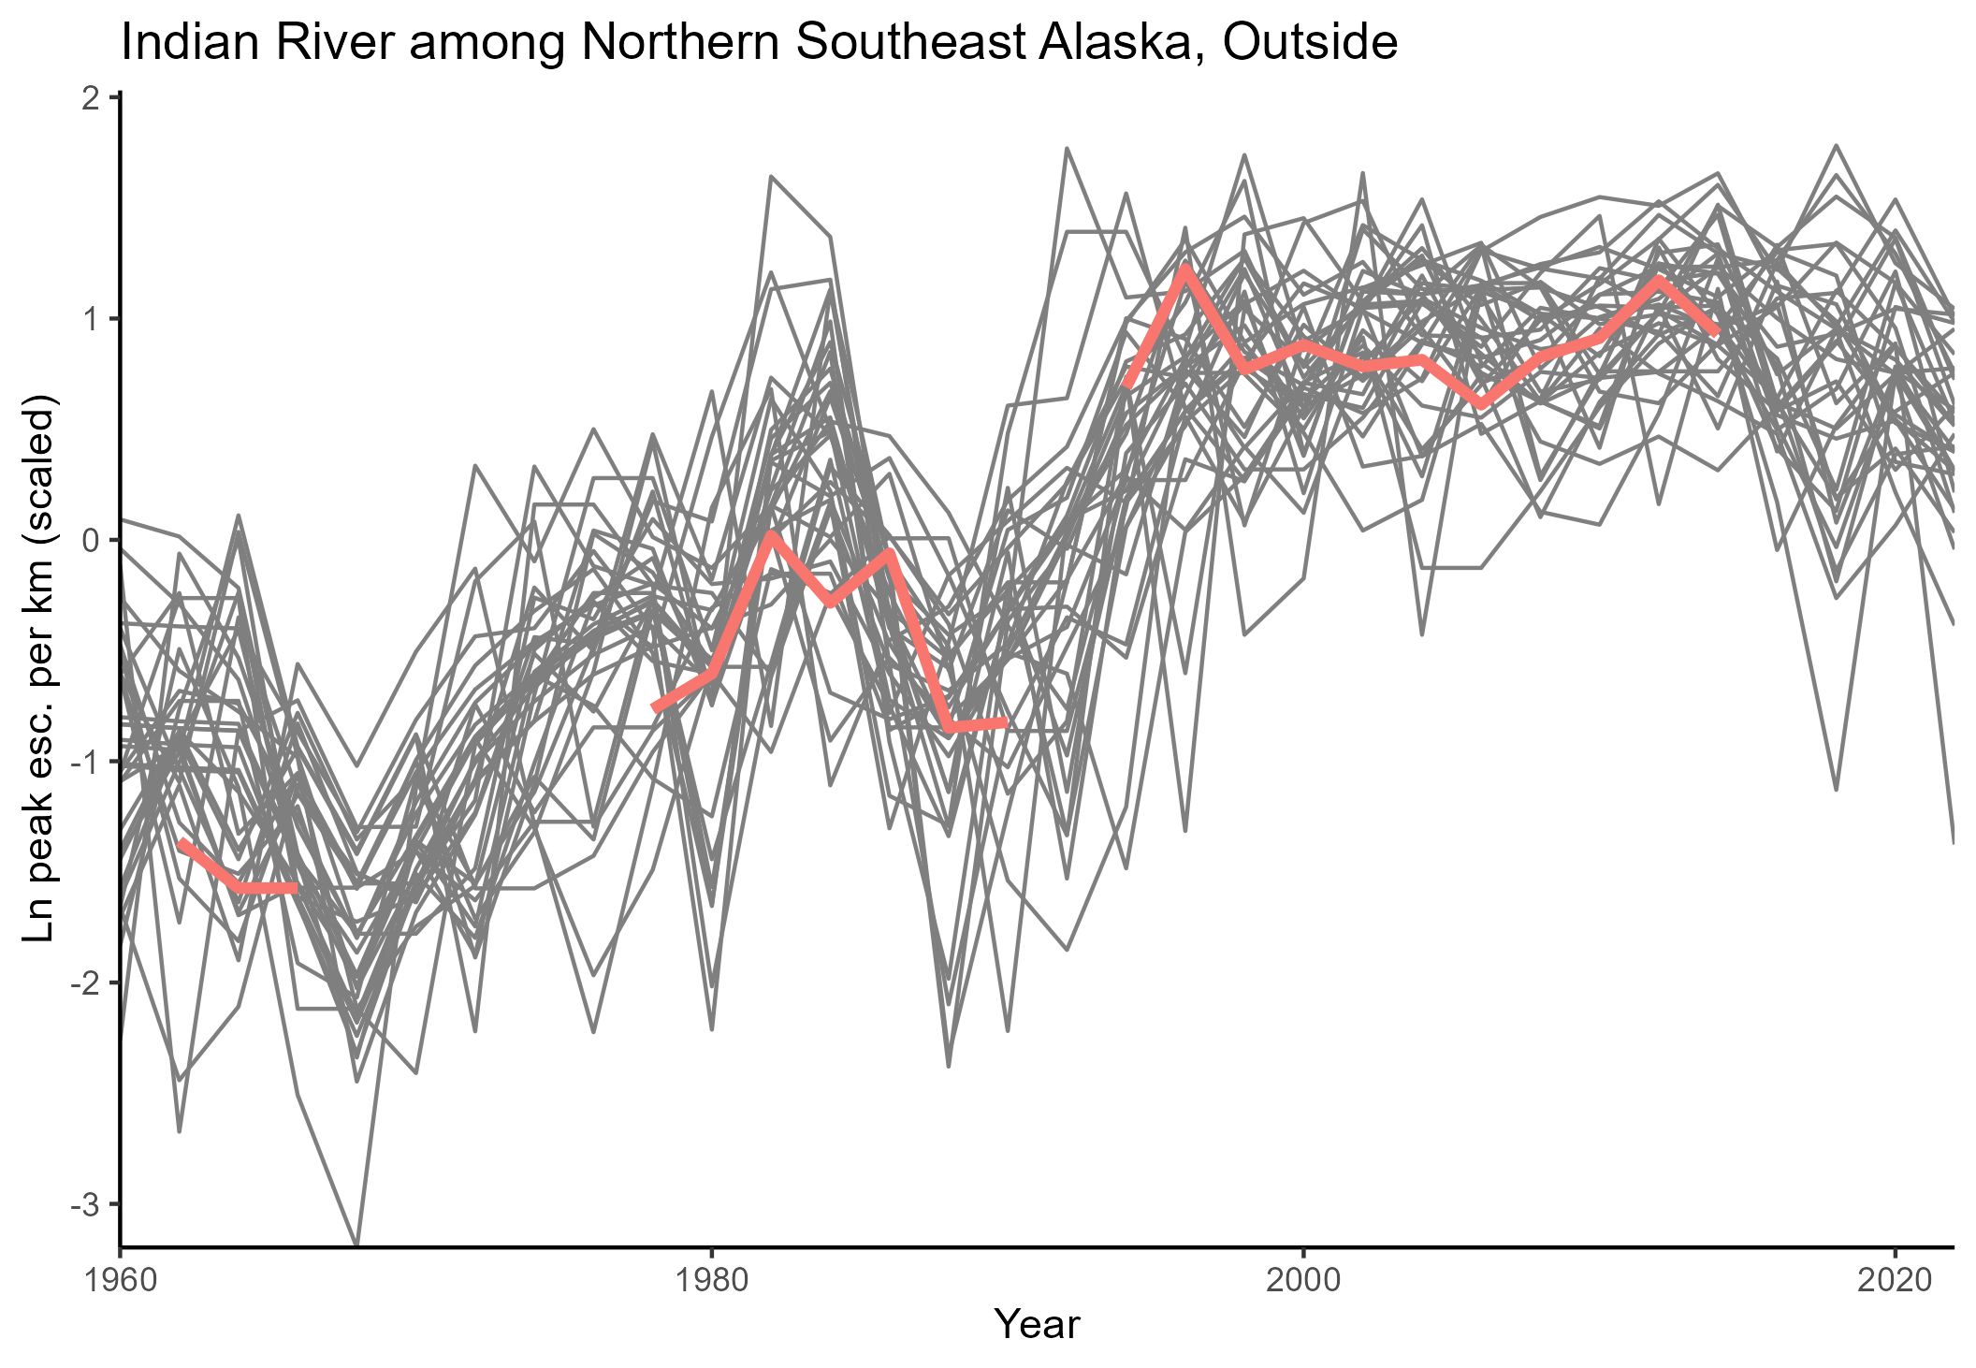
Answer?

Slide 60
Is there a more complete answer?

Slide 61
Where does the Indian River fit in this picture?
xt = Bxt−1 + u + Cct + Gwt, where wt ∼MVN(0,Q) yt = Zxt + a + Ddt + Hvt, where vt ∼MVN(0,R) 😵
State-space model:

Slide 62
Where does the Indian River fit in this picture?
xt = Bxt−1 + u + Cct + Gwt, where wt ∼MVN(0,Q) yt = Zxt + a + Ddt + Hvt, where vt ∼MVN(0,R) 😵 Estimates underlying state (xt) based on observations (yt)
State-space model:

Slide 63
Where does the Indian River fit in this picture?
State-space model allows for:

Slide 64
Where does the Indian River fit in this picture?
State-space model allows for: - Gaps in the observed time series (yt), as seen at in Indian River

Slide 65
Where does the Indian River fit in this picture?
State-space model allows for: - Gaps in the observed time series (yt), as seen at in Indian River

Slide 66
Where does the Indian River fit in this picture?
State-space model allows for: - Gaps in the observed time series (yt), as seen at in Indian River - Treatment of various time series as drawn from some larger underlying state

Slide 67
Where does the Indian River fit in this picture?
State-space model allows for: - Gaps in the observed time series (yt), as seen at in Indian River - Treatment of various time series as drawn from some larger underlying state

Slide 68
Where does the Indian River fit in this picture?
State-space model allows for: - Gaps in the observed time series (yt), as seen at in Indian River - Treatment of various time series as drawn from some larger underlying state - Estimates of variance in year-to-year change in underlying state (xt)

Slide 69
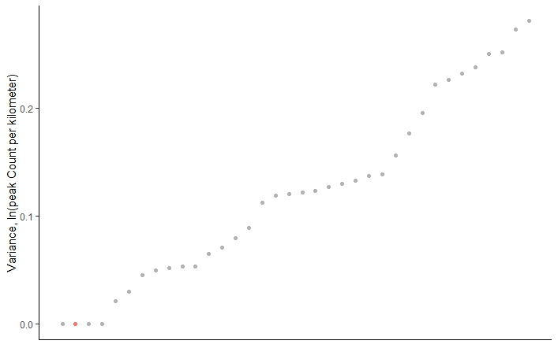
Where does the Indian River fit in this picture?
Variance in year-to-year change

Slide 70
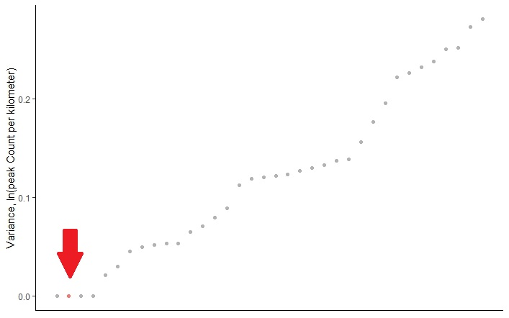
Where does the Indian River fit in this picture?
Variance in year-to-year change
Notes:
Low variance but still comparable to natural index streams

Slide 71
Where does the Indian River fit in this picture?
What about underlying state estimates?
Notes:
Cut back notes on first MARSS model

Slide 72
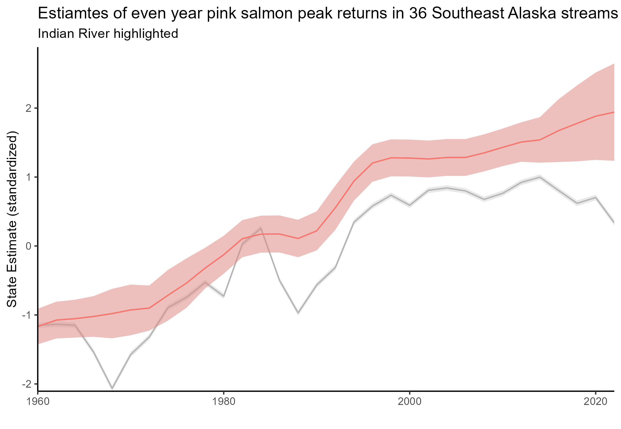

Where does the Indian River fit in this picture?
States – Indian River v. other index streams
Notes:
Cut back notes on first MARSS model

Slide 73
Where does the Indian River fit in this picture?
The system seems a bit unusual in the context of the broader region…

Slide 74
Implications?

Slide 75
Implications
Pink salmon abundance may be due to regional trends

Slide 76
Implications
Pink salmon abundance may be due to regional trends, but somewhat higher than regional average escapement may be due to hatchery releases

Slide 77
Implications
Complicated management challenge

Slide 78
Implications
Complicated management challenge
What is a “natural” condition?

Slide 79
Implications
Complicated management challenge
What is a “natural” condition?
What role is the hatchery playing?

Slide 80
Question 2

Slide 81
Question 2 : How do Sheldon Jackson Hatchery releases impact Indian River escapement?

Slide 82
H0: Sheldon Jackson Hatchery pink salmon releases do not impact the abundance of pink salmon in the Indian River
How do Sheldon Jackson Hatchery releases impact Indian River escapement?

Slide 83
This will require:
How do Sheldon Jackson Hatchery releases impact Indian River escapement?

Slide 84
This will require: - Estimates of Indian River escapement
How do Sheldon Jackson Hatchery releases impact Indian River escapement?

Slide 85
This will require: - Estimates of Indian River escapement - Data regarding stray rates to and from Sheldon Jackson Hatchery
How do Sheldon Jackson Hatchery releases impact Indian River escapement?

Slide 86
This will require: - Estimates of Indian River escapement - Data regarding stray rates to and from Sheldon Jackson Hatchery - Control covariates
How do Sheldon Jackson Hatchery releases impact Indian River escapement?

Slide 87
Recall, observations contain gaps in time series
Indian River escapement

Slide 88
Indian River escapement
MARSS model output estimates underlying state

Slide 89
Estimates of Indian River escapement
How strong are these estimates?
((I’m going to show some residual plots and diagnostics here))

Slide 90
Stray rates

Slide 91
Stray rate data is sparse and messy..

Slide 92
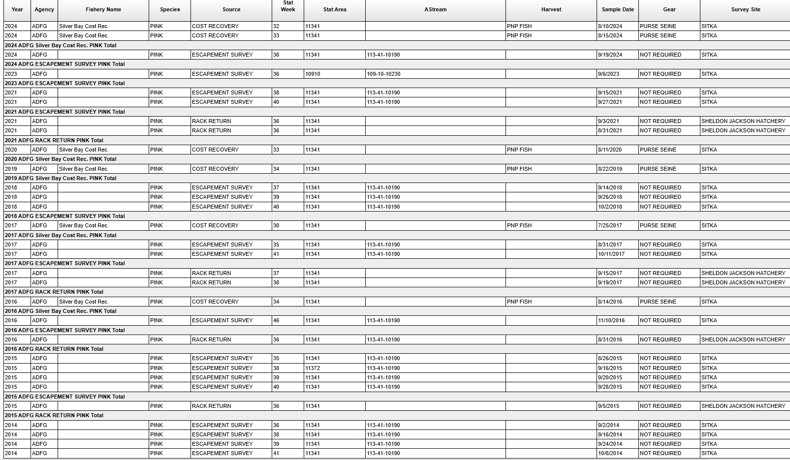
Notes:
This is gross and ugly to look at – trim down to a few rows or bubbles or a timeline or something

Slide 93
Stray rate data is sparse and messy..
38 “good” sampling efforts between Indian River and SJ Hatchery

Slide 94
Stray rate data is sparse and messy..
38 “good” sampling efforts between Indian River and SJ Hatchery
Two major issues:

Slide 95
Stray rate data is sparse and messy..
38 “good” sampling efforts between Indian River and SJ Hatchery
Two major issues:
Ten years b/w 2011 & 2024 with some data available
(only seven with sampling at both sites)

Slide 96
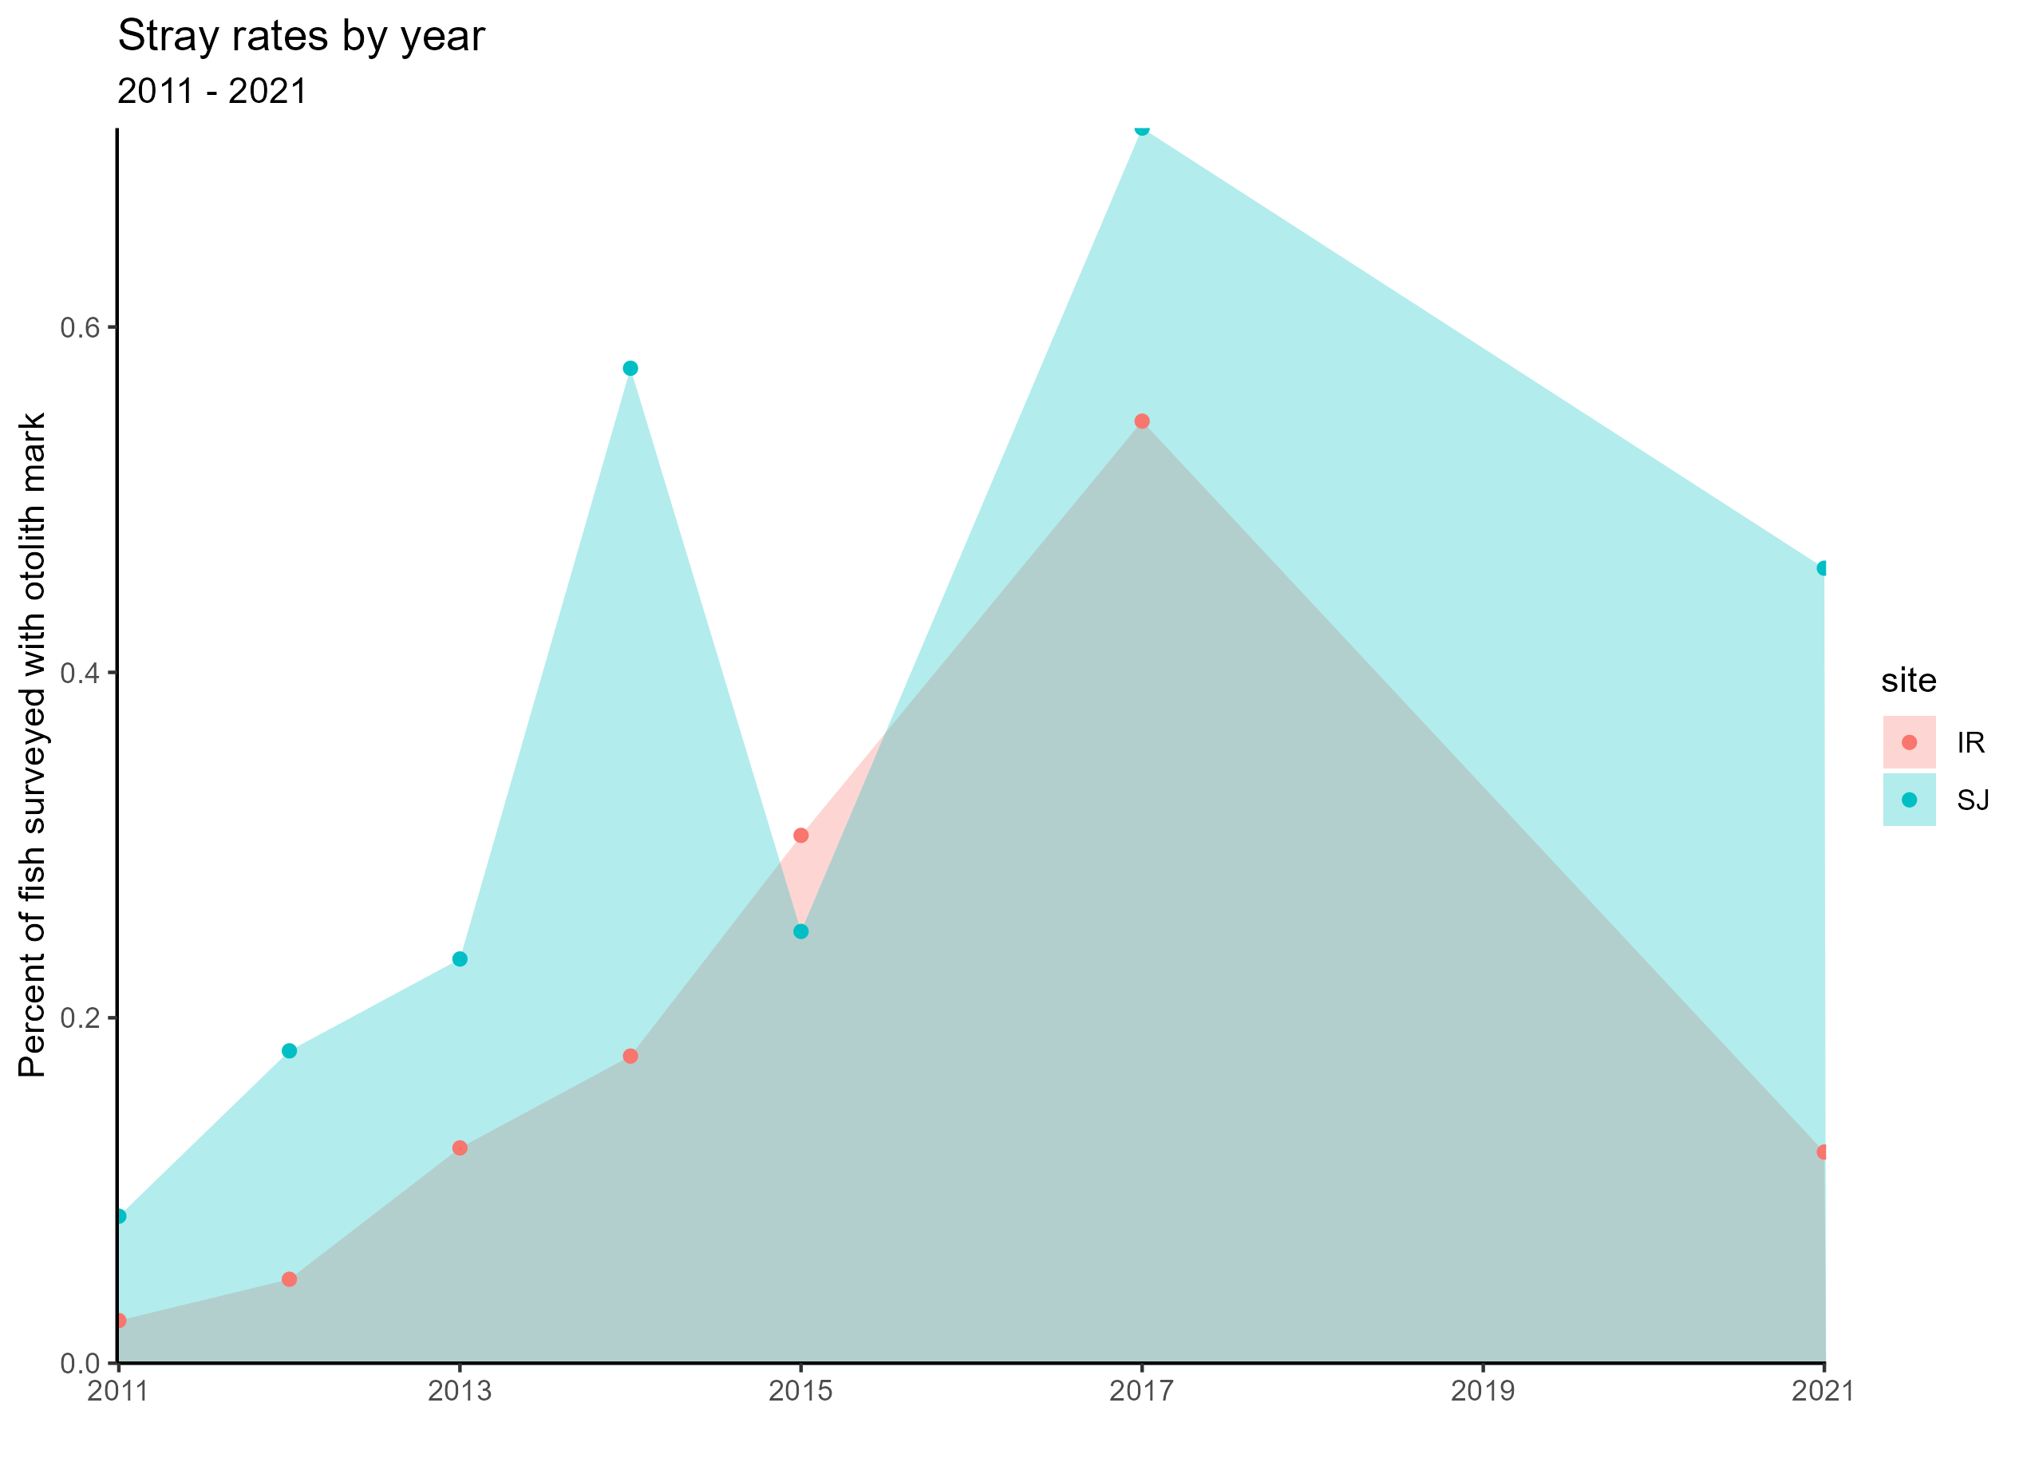
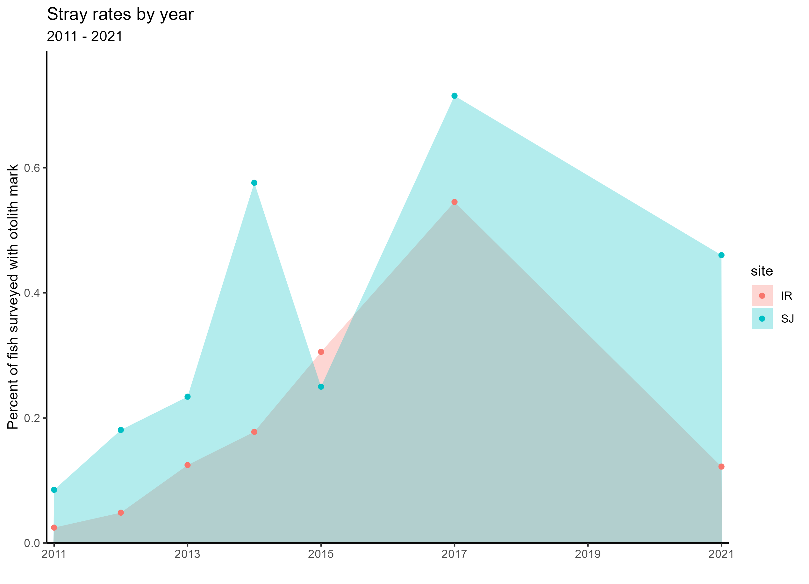
Stray rate data is sparse and messy..

Slide 97
Stray rate data is sparse and messy..
38 “good” sampling efforts between Indian River and SJ Hatchery
Two major issues:
Ten years b/w 2011 & 2024 with some data available
(only seven with sampling at both sites)

Slide 98
Stray rate data is sparse and messy..
38 “good” sampling efforts between Indian River and SJ Hatchery
Two major issues:
Ten years b/w 2011 & 2024 with some data available
(only seven with sampling at both sites)
Inconsistent timing of sampling efforts

Slide 99
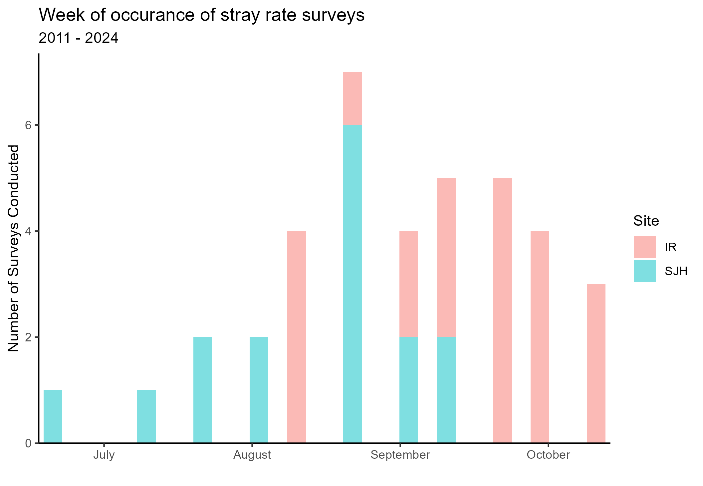
Stray rate data is sparse and messy..

Slide 100
Stray rate data is sparse and messy..

Slide 101
Stray rate data is sparse and messy..
How best to address this lack of information?

Slide 102
Stray rate data is sparse and messy..
How best to address this lack of information?
A Bayesian approach to generate synthetic data?

Slide 103
Stray rate data is sparse and messy..
How best to address this lack of information?
A Bayesian approach to generate synthetic data?
- Literature informs priors

Slide 104
Stray rate data is sparse and messy..
How best to address this lack of information?
A Bayesian approach to generate synthetic data?
- Literature informs priors
- Available data informs likelihood

Slide 105
Stray rate data is sparse and messy..
How best to address this lack of information?
A Bayesian approach to generate synthetic data?
- Literature informs priors
- Available data informs likelihood
Evaluate ranges of potential stray rates?

Slide 106
Stray rate data is sparse and messy..
How best to address this lack of information?
A Bayesian approach to generate synthetic data?
- Literature informs priors
- Available data informs likelihood
Evaluate ranges of potential stray rates?
I would love suggestions and feedback

Slide 107
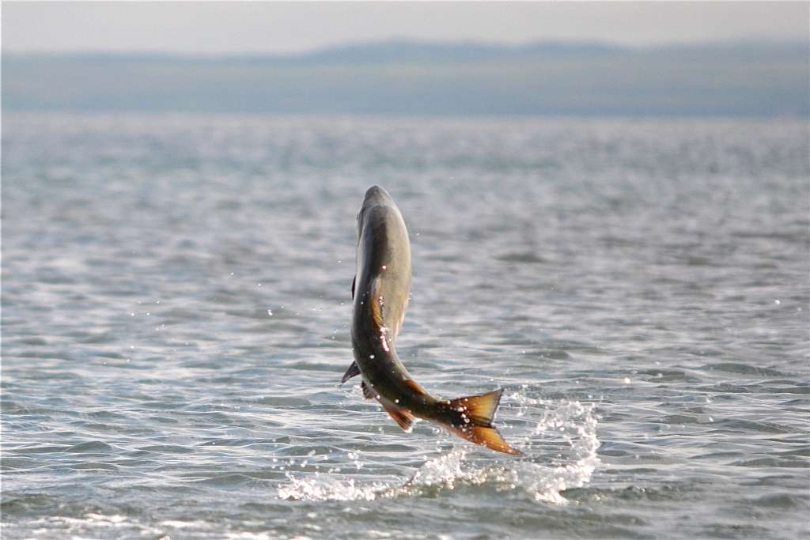
Next steps
Settling on approach to accounting for straying
Possibly including stream level characteristics in MARSS model
Assessment of potential management actions
Credit: US Fish and Wildlife Service

Slide 108





Hyperabundance of endemic species and pink salmon in the Indian River
Brian McGreal bmcgreal@uw.edu

